Slide 1

Desired State Configuration 101 Workshop (v5)
Notes:
Use PowerShell v5. Believe me; just use v5 or another configuration management tool!

Slide 2
Iain Brighton
Principal Consultant @ Virtual Engine
Automation and End-user computing focused
RES Consulting Partner
RES Certified Trainer (RCT) and Valued Professional (RSVP)
Part-time Amateur Developer
PowerShell Junkie

Slide 3
What is DSC?
“A configuration management platform built into Windows that is based on open standards.”
Notes:
Windows PowerShell Desired State Configuration (DSC) is a configuration management platform built into Windows that is based on open standards. DSC is flexible enough to function reliably and consistently in each stage of the deployment lifecycle (development, test, pre-production, production), as well as during scale-out.
DSC centres around "configurations". A configuration is an easy-to-read document that describes an environment made up of computers ("nodes") with specific characteristics. These characteristics can be as simple as ensuring a specific Windows feature is enabled or as complex as deploying SharePoint.
DSC also has monitoring and reporting built in. If a system is no longer compliant, DSC can raise an alert and act to correct the system.

Slide 4
Why Configuration Management
Revision/version control
Configuration identification
Change management
Release management
Accounting and auditing
Notes:
Configuration Management focuses on establishing, and maintaining, the consistency of a system or product throughout its lifetime.
Declarative documents - No implementation details

Slide 5
Components
Configurations
PowerShell-authored
Documents
A DMTF standard
Do not have to generated by PowerShell
Local Configuration Manager (LCM)
Download manager(s) (for configurations and resources)
Refresh mode and interval
Notes:
Configurations can have comment-based help ☺

Slide 6
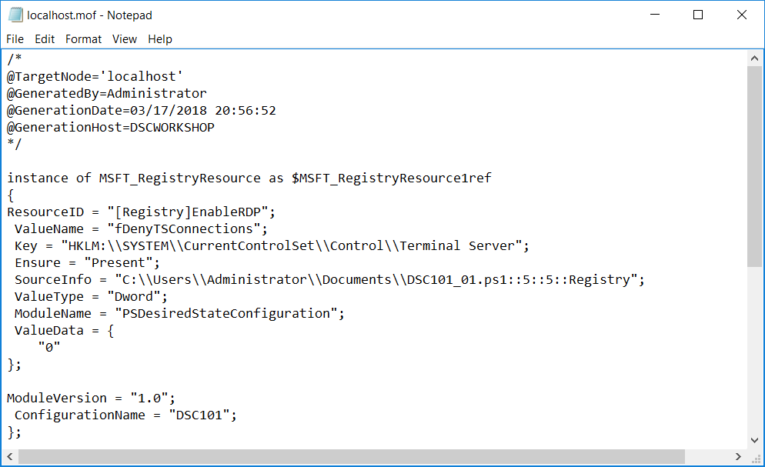

Slide 7
Resources
Types
Binary
Script
Class-based
Idempotent
Manual invocation via Invoke-DscResource
Implement 3 functions/methods
Get-TargetResource
Test-TargetResource
Set-TargetResource
Notes:
To generate mof documents with PowerShell, the DSC resources must reside on the host generating the configuration

Slide 8
Create Simple Configuration
Enable ICMP Echo through firewall using xFirewall resource
Name 'FPS-ICMP4-ERQ-In', inbound on any network profile
Name 'FPS-ICMP6-ERQ-In', inbound on any network profile
Disable Server Manager using Registry resource
HKLM:\Software\Microsoft\ServerManager\DoNotOpenServerManagerAtLogon
Dword: 1
Enable PS Transcription using cAdministrativeTemplateSetting
HKLM:\Software\Policies\Microsoft\Windows\PowerShell\Transcription\EnableTranscripting
Dword: 1

Slide 9
Configuration Parameters
Configurations act just like PowerShell functions:
Parameters
Comment-based help
Includes composite configurations

Slide 10
Create Parameterised Configuration
Create an $ICMP parameter to control whether the firewall rule is enabled
You could use either a [String] or [Boolean] parameter type
[Boolean] will probably require a .ToString() extension method to be used
Create a $DisableServerManager to control whether Server Manager is started or not
You will have fun if you use a [Switch] parameter!

Slide 11
Resource Dependencies
DependsOn enforces the order in which resources are applied
LCM applies resources in the order they apply in a configuration*
A resource can depend on multiple resources, e.g.
DependsOn = ‘[ResourceType]Name1’,’[ResourceType]Name2’
Cross-node dependencies can be configured with the WaitForAll, WaitForAny and WaitForSome resources
DependsOn can be used to wait on the WaitFor* resources
Requires v5
Notes:
* This may not always be the case should parallel execution be implemented.

Slide 12
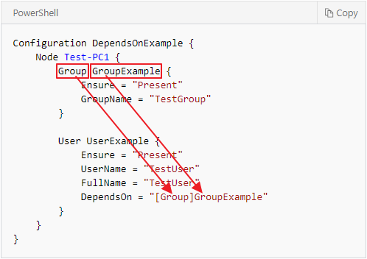
Create Configuration with Dependencies
Update your configuration:
Make the ICMP xFirewall resources dependent on the Server Manager Registry resource
Make the PowerShell Transcription resource dependent on the two ICMP xFirewall resources

Slide 13
Configuration Data
Separation of environmental data
A single configuration can be used with multiple inputs, e.g. differing server names for development, UAT and production
Passed to a configuration when compiled
Defined in a hash table, saved with a .psd1 extension
Can pass either a file path or a hash table
Data is referenced by built-in $AllNodes, $Node and $ConfigurationData variables
Notes:
https://docs.microsoft.com/en-us/powershell/dsc/separatingenvdata
https://docs.microsoft.com/en-us/powershell/dsc/configdata

Slide 14
Handling Credentials
Credential vs PSDSCRunAsCredential
PSDSCRunAsCredential automatic variable added in v5
AllowPlainTextPassword is for lab environments only!
Certificates
Encryption certificates must contain the Data Encipherment or Key Encipherment key usage, and
Include the Document Encryption enhanced key usage
Added requirement in v5
Notes:
Credential needs to be implemented by the resource.
PSDSCRunAsCredential (added in v5) executes the resource under the specified credential

Slide 15
Certificates
These steps need to be performed in an Administrator PowerShell session
$cert = New-SelfSignedCertificate -Type DocumentEncryptionCertLegacyCsp -DnsName 'DscEncryptionCert' -HashAlgorithm SHA256
$cert | Export-Certificate -FilePath ~\DscPublicKey.cer -Force

Slide 16
Composite Resources
Are reusable configurations
Import the composite configurations just like DSC resources
Look just like configurations
Contain the Configuration keyword
Saved with the .schema.psm1 file extension
Notes:
Example: https://github.com/VirtualEngine/VirtualEngineLab

Slide 17
Push and Pull (and Tug)
Default installation configured for push mode
Pull servers enable central configuration
LCM (node) is registered with the pull server
Assigned one or more configurations
Resources can be automatically downloaded
Available options:
Azure Automation DSC
Windows Server DSC pull service*
SMB share*
Tug and Traek
Resources are zipped, with checksums
Notes:
* SQL support added in Windows Server Current Branch (1803)
* Configuration names are not supported with the SMB pull server (only configuration IDs)
A Windows Server DSC pull service can be deployed using the xDSCWebService resource!
Checksums are created using the New-DscChecksum cmdlet

Slide 18
Partial Configurations
Introduced in Windows PowerShell v5
Allows configurations to be delivered in fragments and from multiple sources
The Local Configuration Manager (LCM) on the target node puts the fragments together before applying them as a single configuration
This capability allows sharing control of configuration between teams or individuals
Publish-DscConfiguration used when pushing partial configurations
Notes:
https://docs.microsoft.com/en-us/powershell/dsc/partialconfigs

Slide 19
Troubleshooting
Microsoft\Windows\Desired State Configuration event logs
LCM DebugMode: All
Authoring resources:
LCM DebugMode: ForceModuleImport
Invoke-DscResource
Notes:
https://docs.microsoft.com/en-us/powershell/dsc/separatingenvdata

Slide 20
PowerShell Core
New LCM written in C++
To be made open-source
New provider model
First provider being Windows PowerShell
No changes to resources required*
PowerShell Core, C++ and Python planned
Notes:
* Famous last words!
https://blogs.msdn.microsoft.com/powershell/2018/01/26/dsc-planning-update-january-2018/

Slide 21
Lability

Slide 22
Questions?

Slide 23
Links
https://docs.microsoft.com/en-us/powershell/dsc/index
https://blogs.infosupport.com/safely-using-pscredentials-in-a-powershell-dsc-configuration/
https://docs.microsoft.com/en-us/powershell/dsc/bootstrapdsc
https://docs.microsoft.com/en-us/powershell/dsc/resourceauthoringchecklist
Notes:
Declarative document -

Slide 24
Thanks for listening!
iain.brighton@virtualengine.co.uk
@iainbrighton

Slide 25
Why Not Use DSC?
Infrastructure as code
Requires orchestration
AWS CloudFormation
Azure Resource Templates
Chef and Puppet etc.
Notes:
Declarative document -

Slide 26
DSC 1.0 Updates
KB 2883200
%ProgramFiles%\WindowsPowershell\Modules
KB 3000850
Start-DSCConfiguration –UseExisting
Stop-DSCConfiguration
Remove-DSCConfigurationDocument
Update-DSCConfiguration

Slide 27
DSC 2.0 Enhancements
Scheduled Tasks Removed
Class-based Resources
Push and Pull Partial Configurations
PsDscRunAsCredential

